Slide 1
Grading System (Final Group Project)
Group Members:
Abdul Rahman Hamad Alhamadi

Slide 2
Introduction
Grading System is a GUI based Java desktop application which is programmed to calculate SGPA of a student.
Initially all fields are blank.
It calculates the SGPA of a student. Once SGPA is calculated then it determines the Standing and Rank from SGPA.

Slide 3
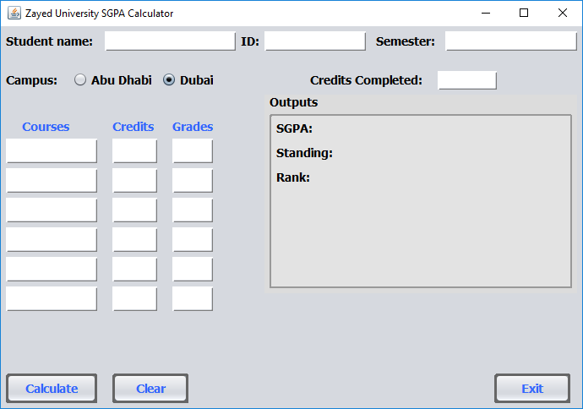
Initial Display
Initially its blank

Slide 4
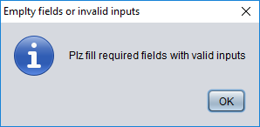
Criterion for successful calculation
For application to calculate GPA successfully, following conditions should be met.
Credits column should be filled completely
Grades column should be filled completely
User should enter some value for credits completed
If the above three conditions are met properly then application will calculate GPA, Standing & Rank successfully otherwise it will display a popup given below.

Slide 5
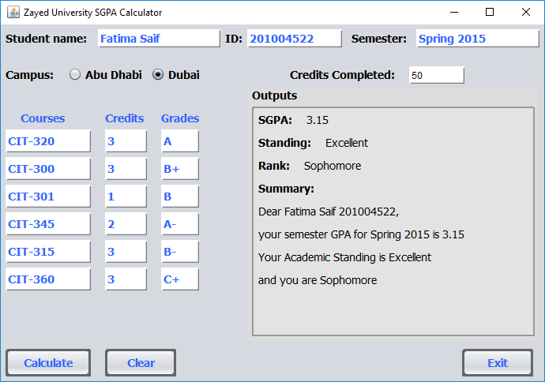
Successful working

Slide 6
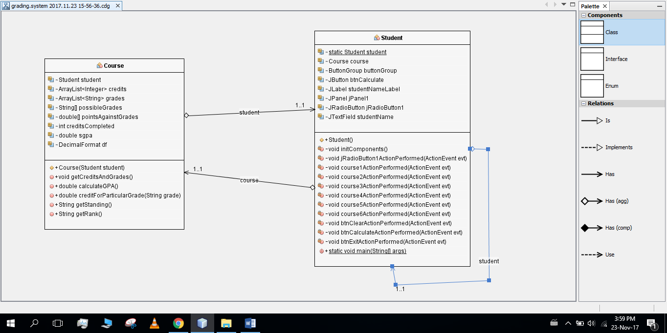
Uml class diagram

Slide 7


Slide 8


